Slide 1
TypeScript
Getting Started with TypeScript
Lecture 1
By James(Jin) Wang
11/15/2021

Slide 2
Outline
Why TypeScript?
TypeScript Features
TypeScript Syntax, Keywords and Code Hierarchy
Tooling/Framework Options

Slide 3
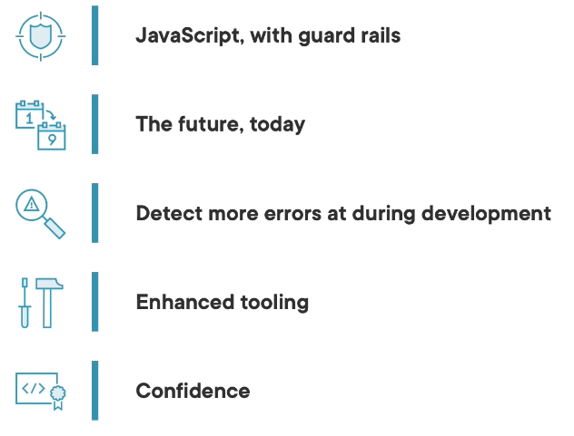
Why TypeScript

Slide 4
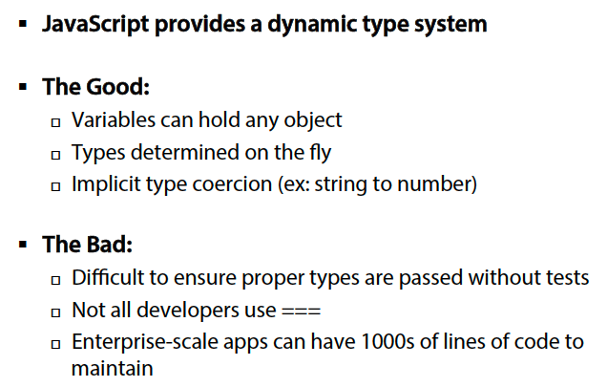
Why TypeScript
  JavaScript Dynamic Types:

Slide 5

Why TypeScript
  Migrating from Server-Side to Client-Side:
  Migrating from server-side apps to client-side apps can be challenging

Slide 6
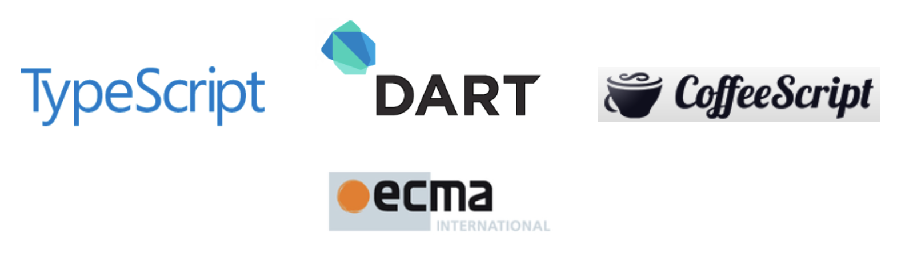
Why TypeScript
  What are the Alternatives?
  Several TypeScript alternatives exist:
  Write pure JavaScript
  Apply JavaScript patterns
  CoffeeScript
  Dart

Slide 7
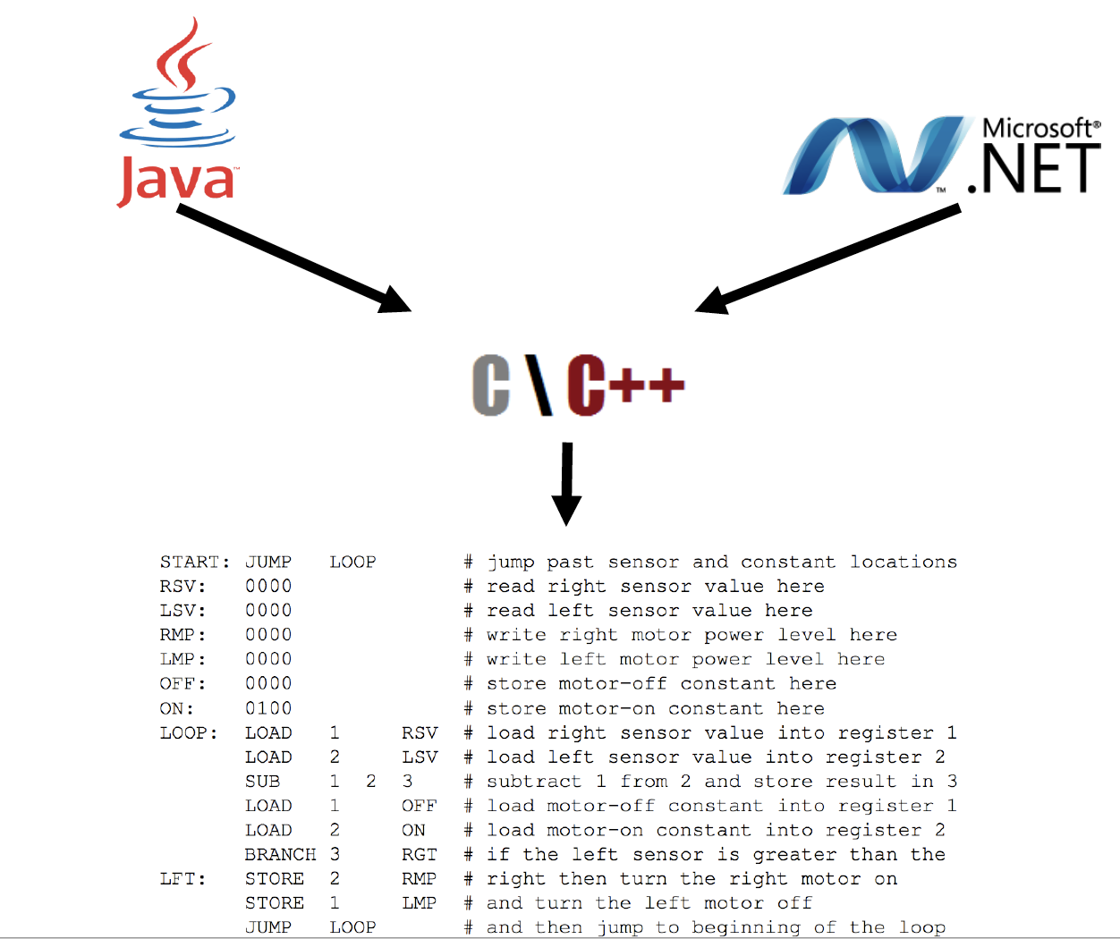
Why TypeScript
  Should we Simply Write Plain JavaScript?

Slide 8

TypeScript Features
  What is TypeScript?

Slide 9
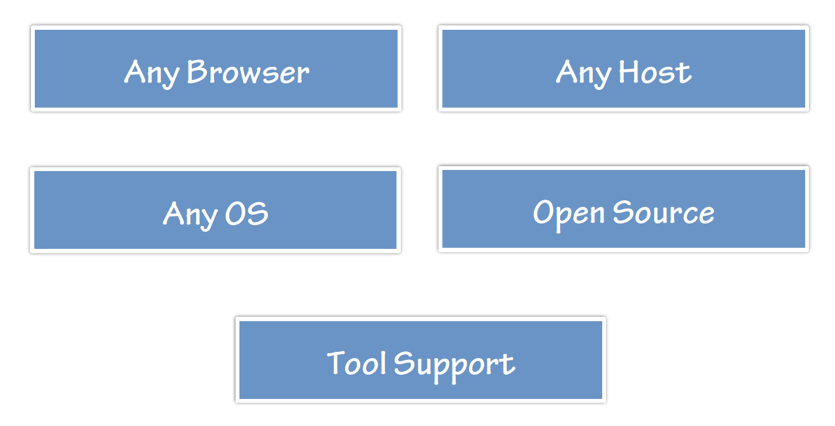
TypeScript Features
  Flexible Options:

Slide 10
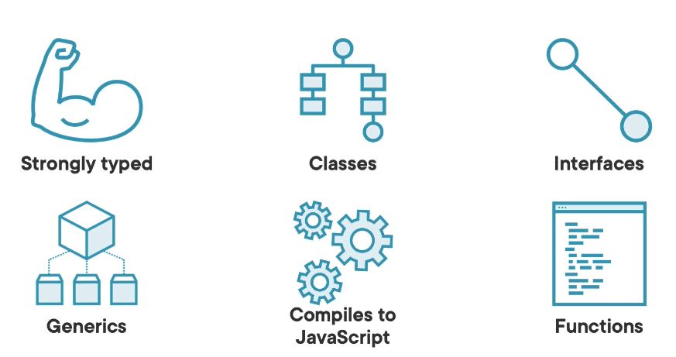
TypeScript Features
  Key TypeScript Features:

Slide 11
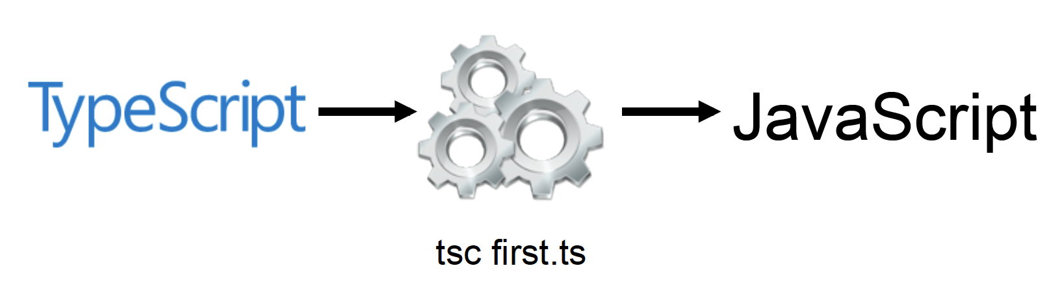
TypeScript Features
  TypeScript Compiler:

Slide 12
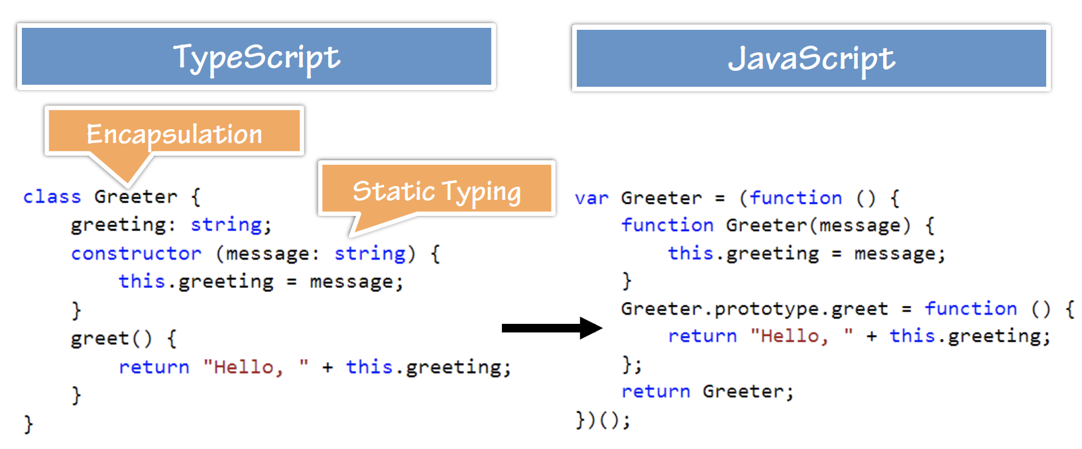
TypeScript Features
  TypeScript -> JavaScript:
  Demo: Greeter

Slide 13
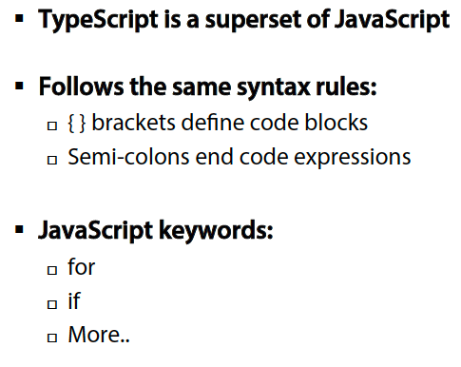
TypeScript Syntax, Keywords and Code Hierarchy
  TypeScript Syntax Rules:

Slide 14
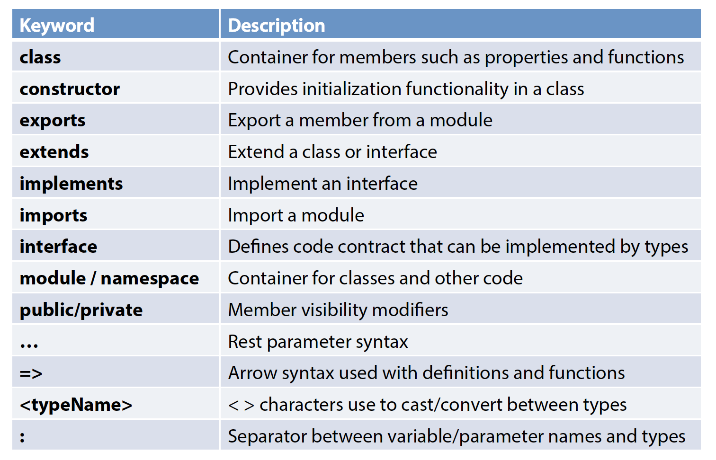
TypeScript Syntax, Keywords and Code Hierarchy
  Important Keywords and Operators:

Slide 15
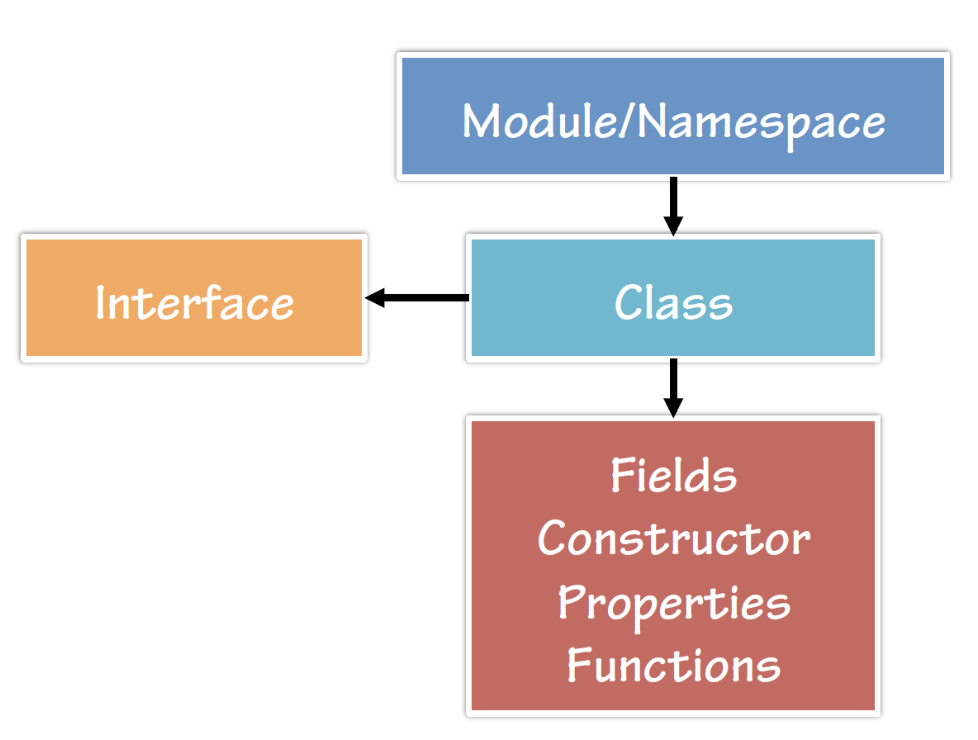
TypeScript Syntax, Keywords and Code Hierarchy
  Code Hierarchy:

Slide 16
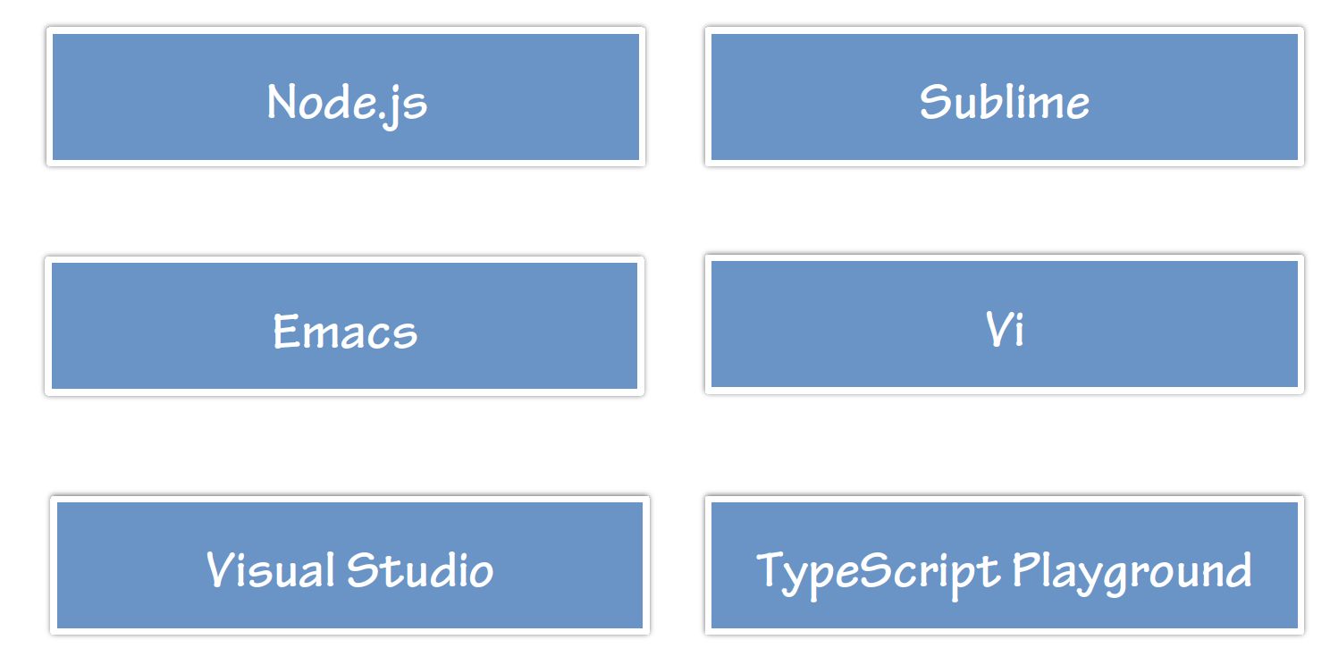
Tooling/Framework Options
  Tool/Framework Support:

Slide 17
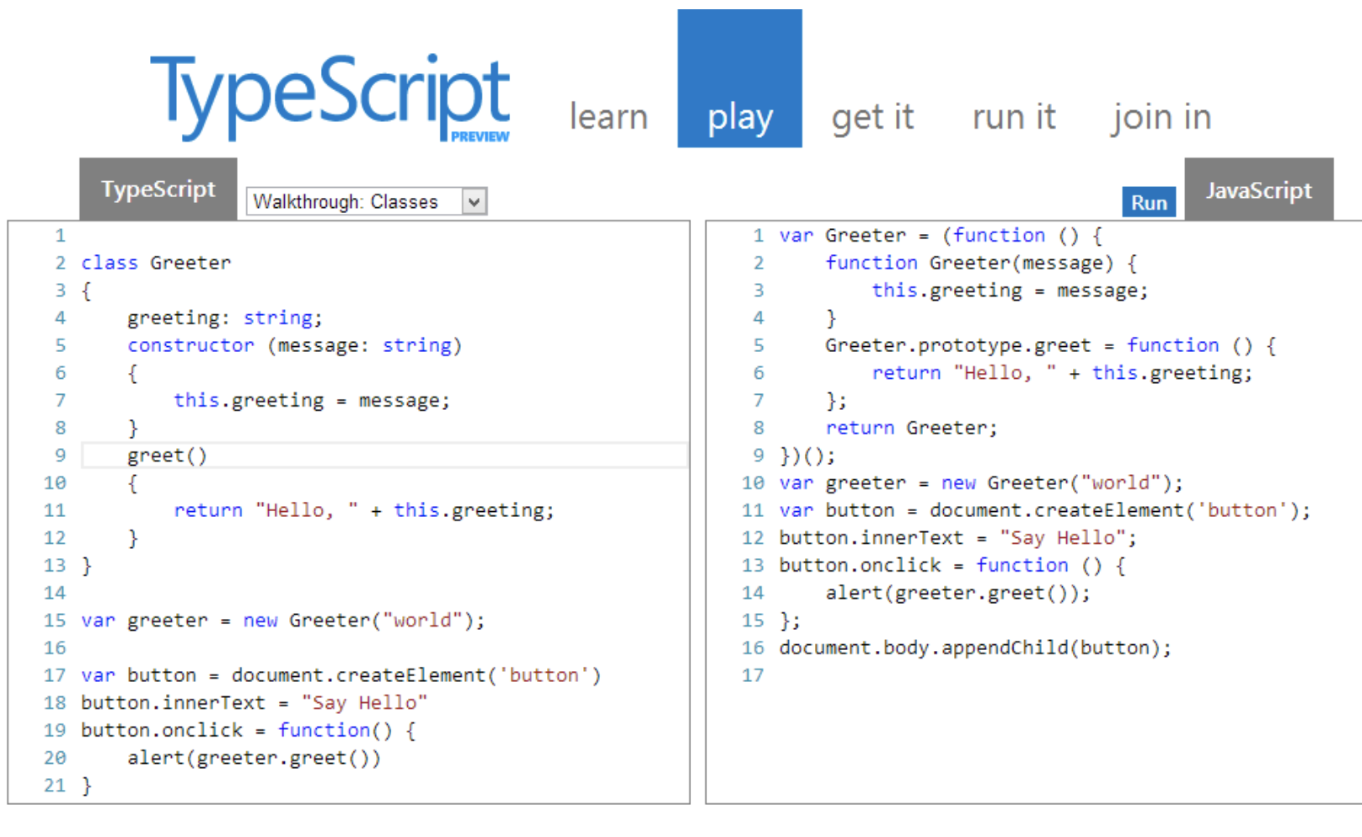
Tooling/Framework Options
  Demo: HelloWorld

Slide 18
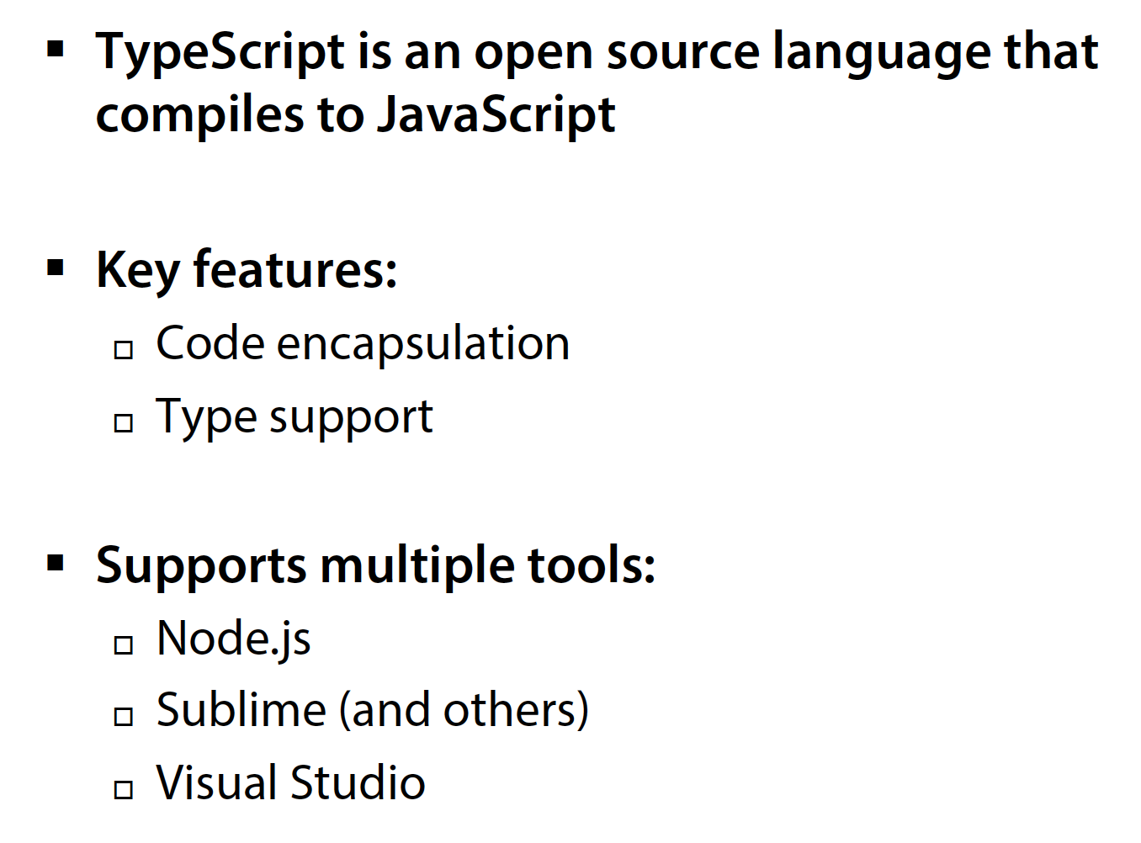
Summary

